Slide 1
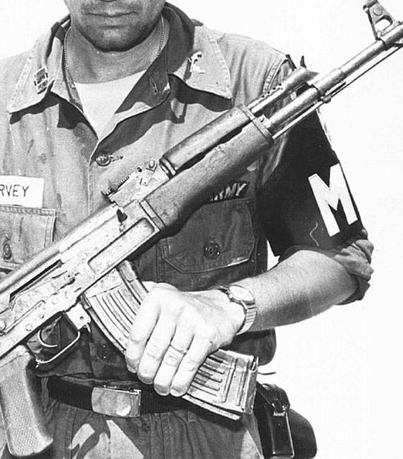
Global exchange
AK-47

Slide 2
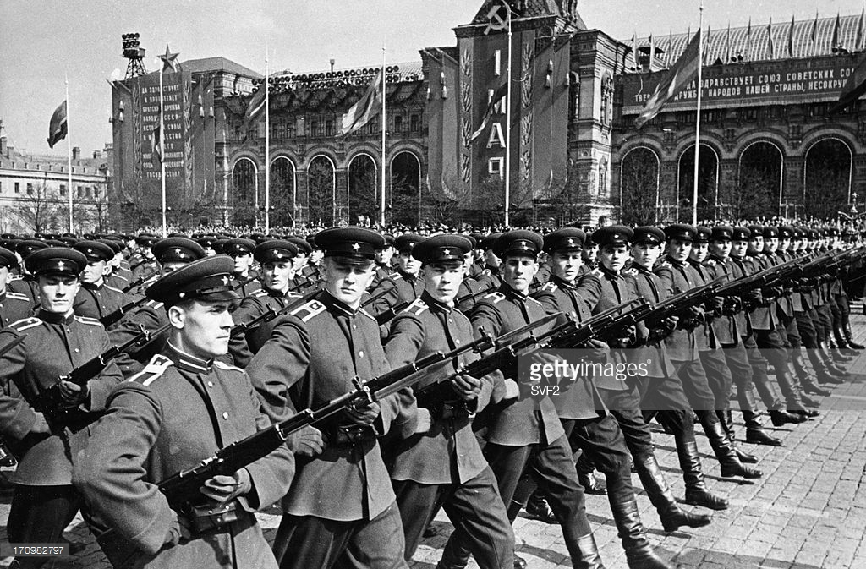
Origin
Notes:
It was first created and used in USSR and than became popular all around the world

Slide 3
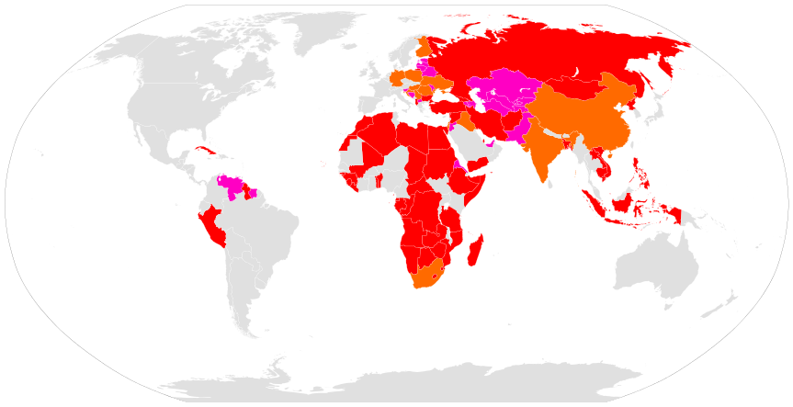
Around the world
Notes:
AK-47 is the most used weapon on the planet. There are 150 million variants of AK-47 around the world which is 1 for every 50 people on Earth. Right now it is mostly used in Africa and Middle east. Right now there are about 50 countries which adopted the weapon in armies.

Slide 4
Why so popular?

Slide 5
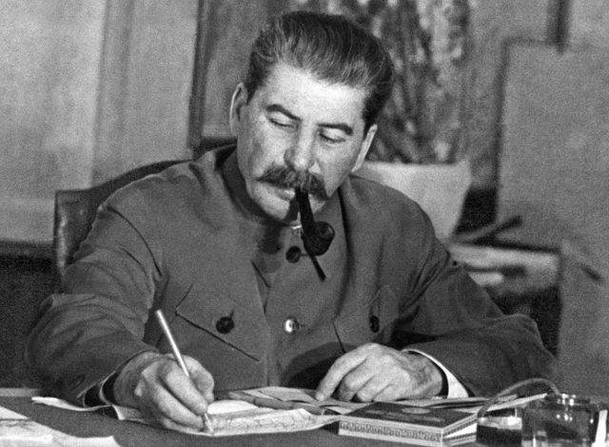
World’s state and USSR’s position
Notes:
Mainly due to USSR’s position and state of the world

Slide 6
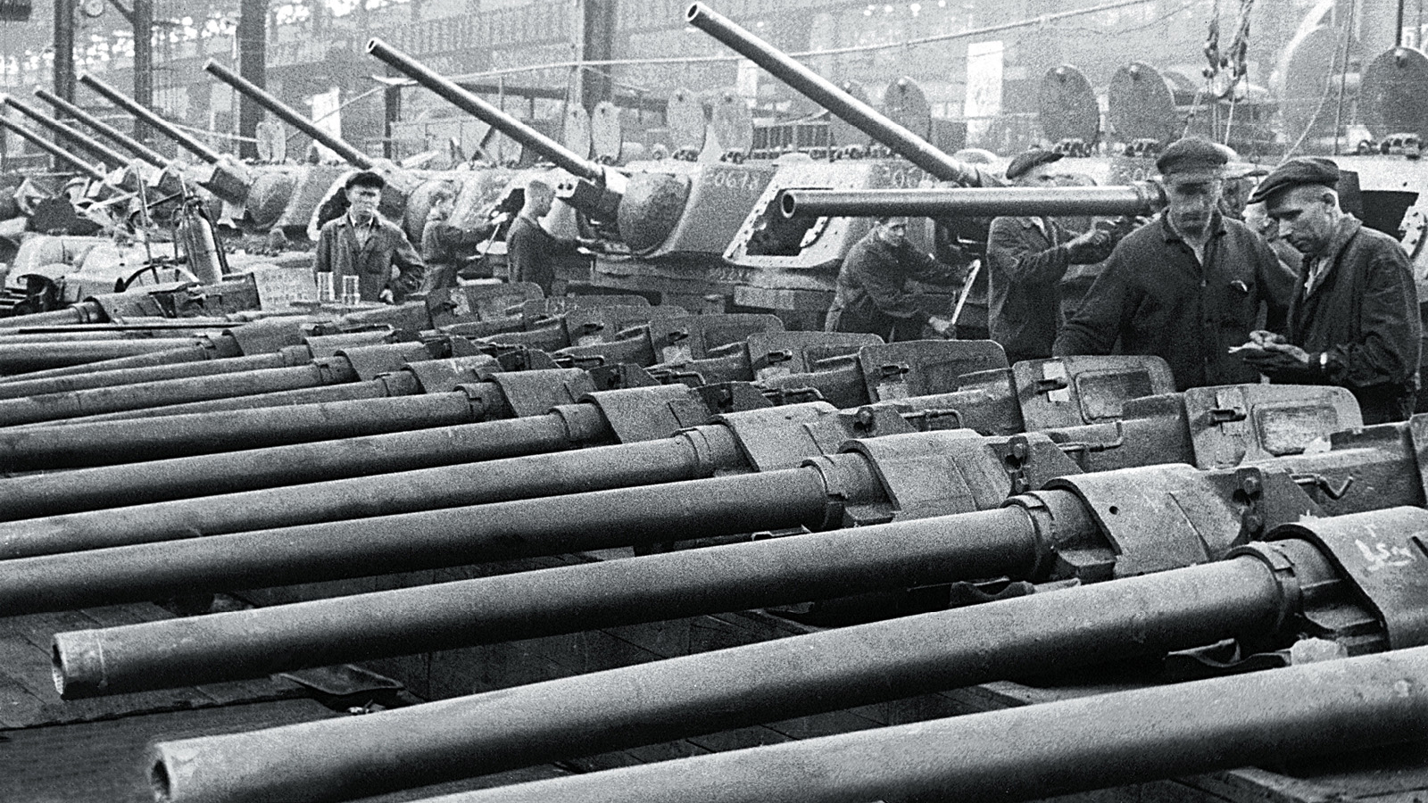
Fully ready
Notes:
USSR military industry became significantly stronger and more effective at production and development of modern weapons. Because of that USSR began to sell weapons to other countries in large amounts, it’s became soviet commodity.

Slide 7
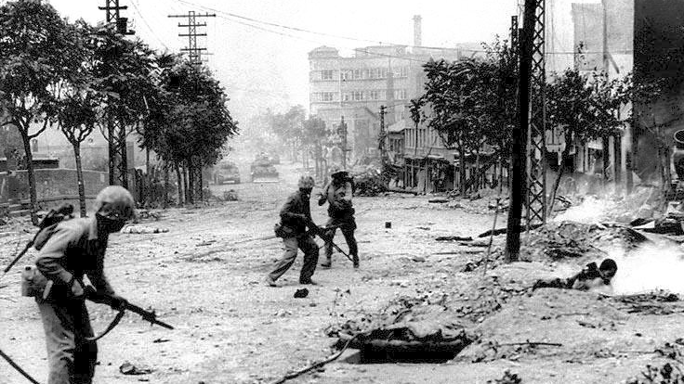
Possible consumers
Notes:
Wars and revolutions were very common after WW2 so there was a demand for weapons and that is how AK-47 started to globalize itself. Plus USSR exported for free AK-47 to countries which they wanted to support and encouraged their manufacturing there.

Slide 8
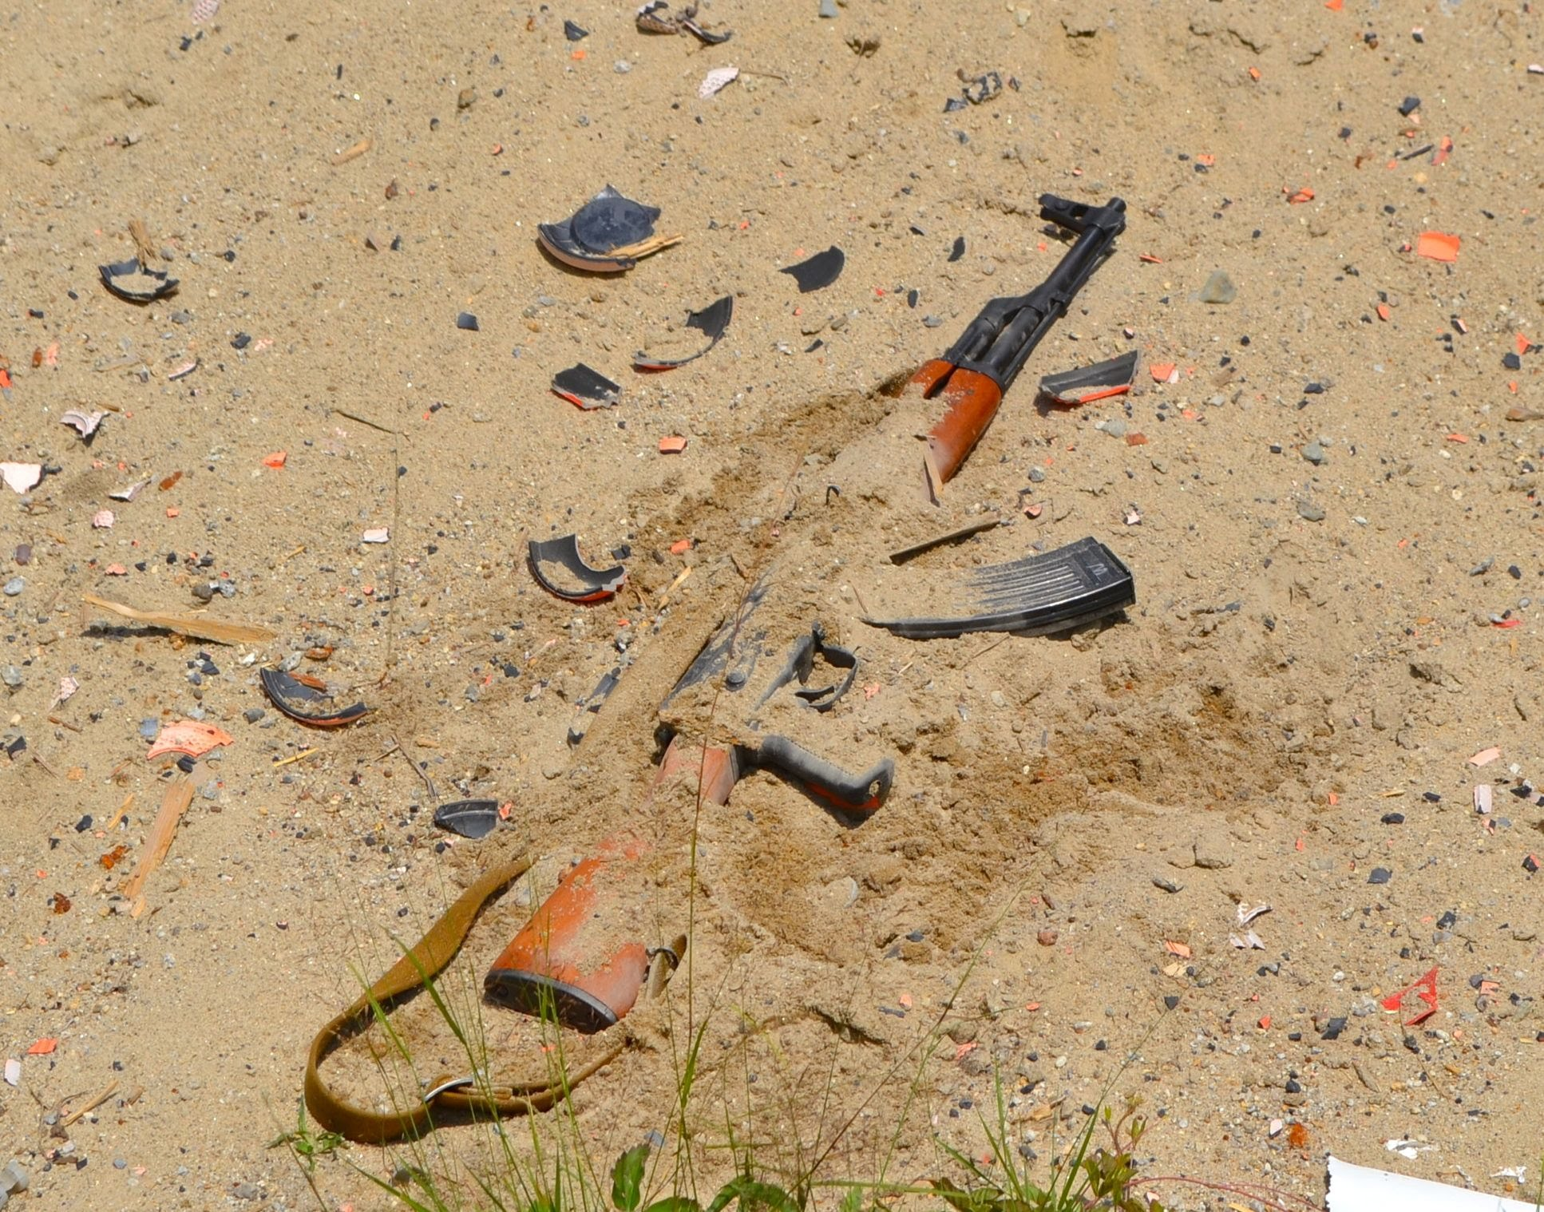
2nd reason: Qualities
Notes:
The major reason why AK-47 became very popular is mainly due to it’s durability. It is easy to manufacture, easy to repair if breaks, plus it doesn’t get jammed which makes it perfect for dirty and sandy conditions. The service life of AK is 20-40 years and it doesn’t need to be constantly maintaned.

Slide 9
Influence

Slide 10
Notes:
Some countries which went through revolution, now have AK-47or close representation on them. For example Mozambique, which has AK-47, a book and a hoe.

Slide 11
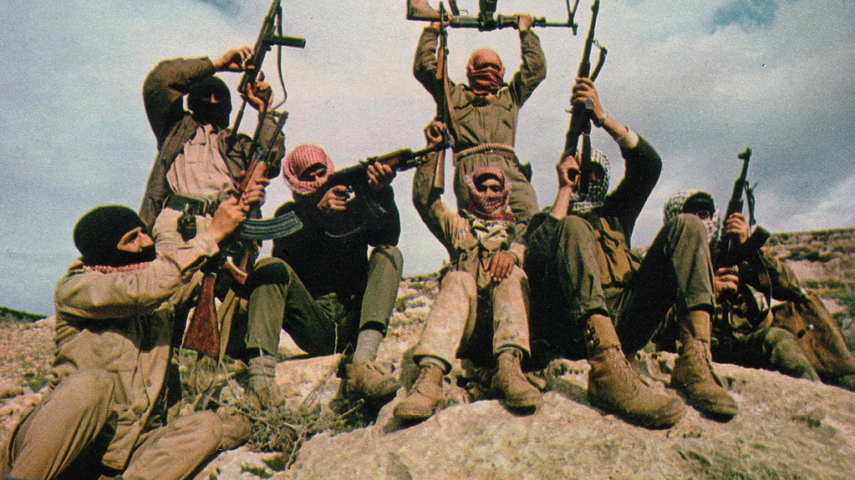
Conflict supporter
Notes:
It is responsible for making every large-middle or small middle east conflict possible. Also it caused the most deaths in modern conflicts.

Slide 12
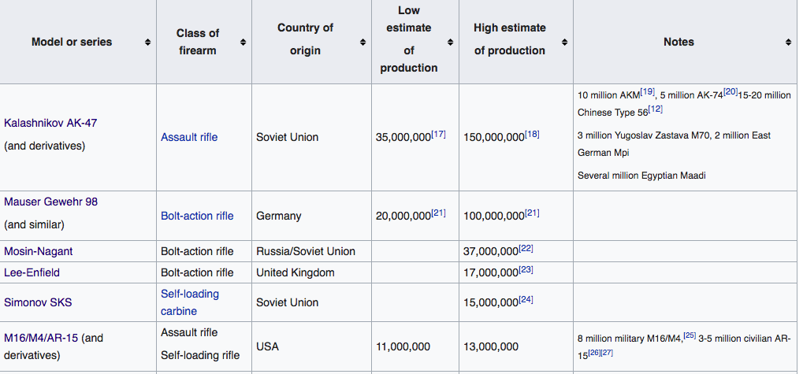
Most produced weapons
Notes:
As we can see

Slide 13
Film industry
Notes:
Used in film industry, usually to represent bad guys

Slide 14
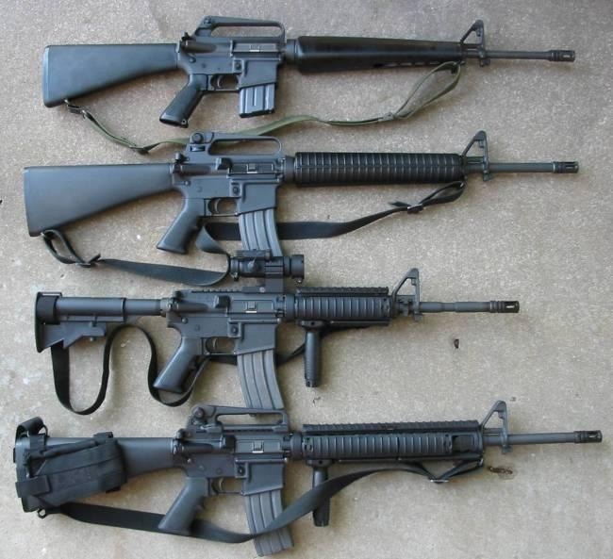
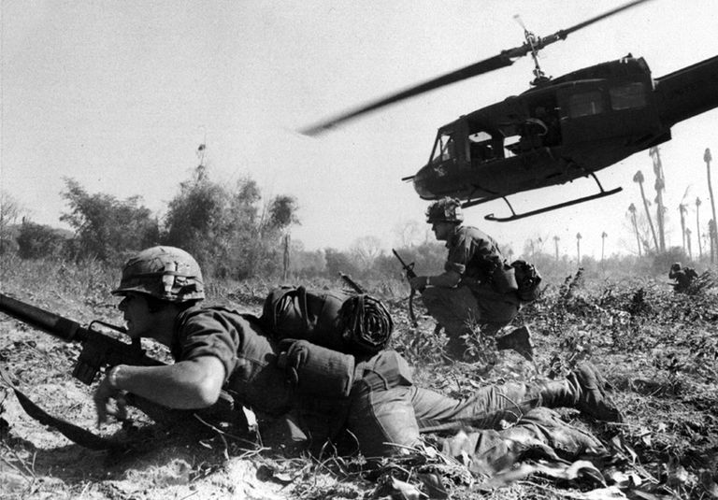
Progress inspiration
Notes:
Encouraged further development of the fire-arms as it was very revolutionary for the time. This was especially seen in Vietnam war where one where singal vietcong soldier to stop the marine squad from advancing forward. AK-47 was partly responsible for development of quiet famous M-16.

Slide 15
The End

